Slide 1


Introduction
ACCESSDATA® FORENSICS
Gathering Evidence and Reporting
Forensic Analysis
Incident Response
eDiscovery
Information Assurance

Slide 2
Module Objectives
Accessing a null-terminated “hidden” key
Accessing Protected Storage (PSSP)
Using a SAM file to determine logon time
Using a SYSTEM file to determine a
machine’s active time bias
Using the SOFTWARE file to determine
Current Version settings
Processing System Volume Information

Slide 3
As A Thought………
Recent Document List
IM Contacts
Recent File Run List
FilShare Info
Registered Owner Information
Chat Room Info
Internet Explorer Typed URLs
ID Alias Info
Time Bias Info
Mounteed Devices/Drive
Profile Info
FilShare Info
Protected Storage
OS Version Info
Wireless Connections
Media Player History Lists
And that’s barely scratching the surface…

Slide 4
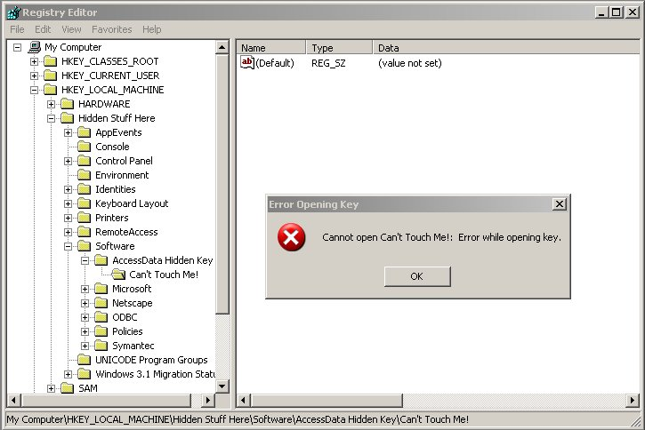
Gathering Evidence
Accessing a null-terminated “hidden” key value
Use a tool that
bypasses the
Windows API
Notes:
“Hidden Key” Reference
A subtle but significant difference between the Win32 API and the Native API is the way that names are described. In the Win32 API strings are interpreted as NULL-terminated ANSI (8-bit) or wide character (16-bit) strings. In the Native API names are counted Unicode (16-bit) strings. While this distinction is usually not important, it leaves open an interesting situation: there is a class of names that can be referenced using the Native API, but that cannot be described using the Win32 API.
How is this possible? The answer is that a name which is a counted Unicode string can explicitly include NULL characters (0) as part of the name. For example, "Key\0". To include the NULL at the end the length of the Unicode string is specified as 4. There is no way to specify this name using the Win32
API since if "Key\0" is passed as a name, the API will determine that the name
is "Key" (3 characters in length) because the "\0" indicates the end of the name.
When a key (or any other object with a name such as a named Event, Semaphore or Mutex) is created with such a name, applications using the Win32 API will be unable to open the name, even though they might seem to see it.

Slide 5
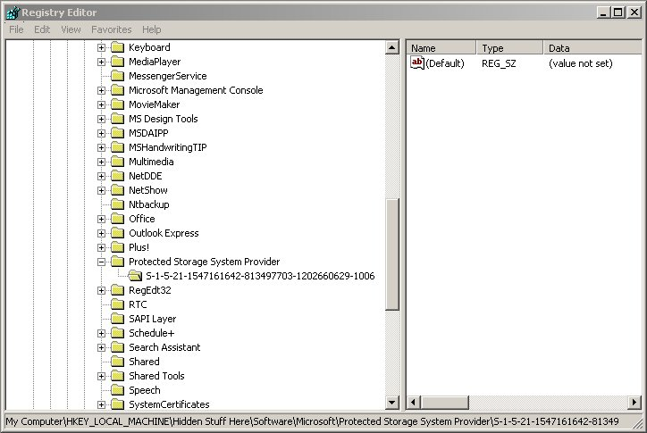
Gathering Evidence
Accessing the Protected Storage Area
(Protected Storage System Provider key)
Use a tool that
bypasses the
Windows API
AND decrypts
the values !
?

Slide 6
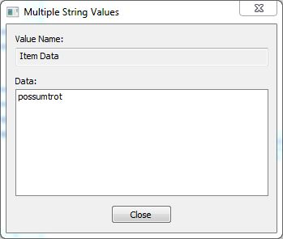
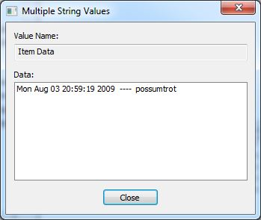
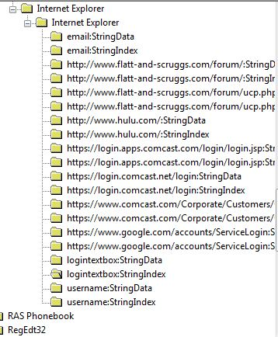
String Data and String Index

Slide 7
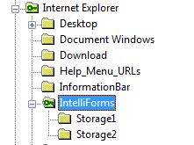
Intelliforms
PSSP not used in Internet Explorer 7 and higher
Artifacts are now stored in Intelliforms
  Storage 1 Queries and Form Data
  Storage 2 Passwords

Slide 8
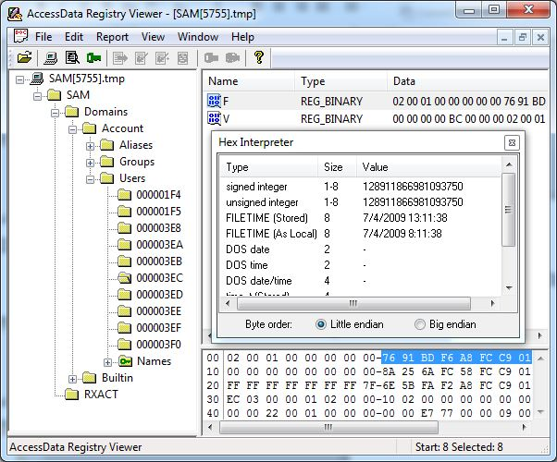
Gathering Evidence
Using a SAM file to determine a user’s:
Last logon time
Unique SID ID
Be sure to have
a hex interpreter
handy for this !

Slide 9
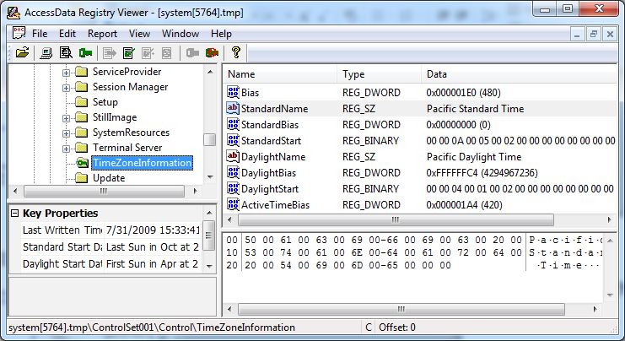
Gathering Evidence
Using a SYSTEM file to determine time bias
So many
things
are GMT
relative

Slide 10
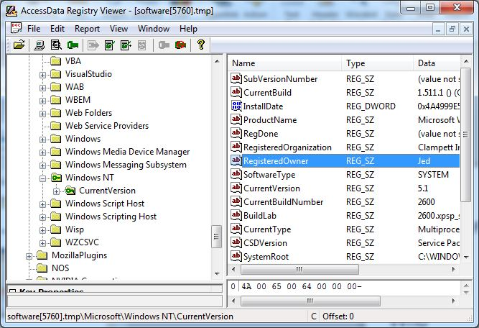
Gathering Evidence
Using a SOFTWARE file to determine settings
Who
What
When
Where
Why

Slide 11
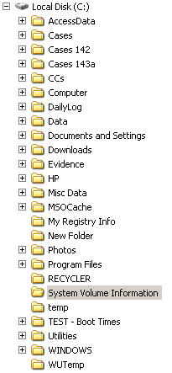
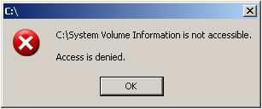
System Volume Information
System Volume Information (SVI)
Protected %Root% System Folder
Restore Point Information !

Slide 12
SVI - Restore Points
Win XP and 2K
“Sets Restore Point” Every 24 Hours
Registry and Other System Files
200 MB Minimum (up to 12% of Disk)
Backups Kept for 90 Days

Slide 13
Restore Points
Backups of the Registry
(Among other things)
Cases
  Trojan Defense Revisited
  Did They or Didn’t They Visit That Site?
  Suspect Used Wiping Software
Imager & FTK can access SVI

Slide 14
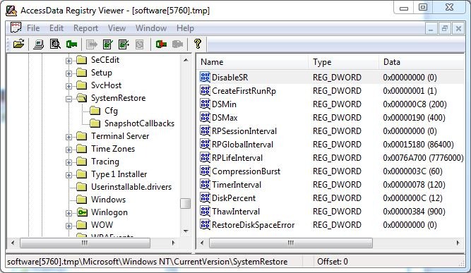
Restore Point Settings
SOFTWARE \ Microsoft \ WindowsNT \ CurrentVersion \ SystemRestore

Slide 15
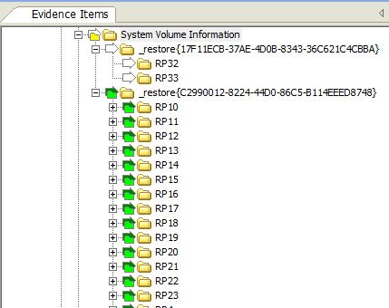
Forensic Issues – Restore Points
Restore Points are numbered

Slide 16
Module Review
Accessing a null-terminated “hidden” key
Accessing Protected Storage (PSSP)
Using a SAM file to determine logon time
Using a SYSTEM file to determine a
machine’s active time bias
Using the SOFTWARE file to determine
Current Version settings
Processing System Volume Information

Slide 17



